Slide 1
Modern Web Development
Nicholas Pierce

Slide 2
Pip and NPM install
Npm install sqlite3, npm install nodejs, npm install express, npm install bodyParser
Pip install bottle, pip install gmplot, pip install beautiful soup, pip install geocoder
Neither of these are great.

Slide 3
Node.js and Bottle

Slide 4
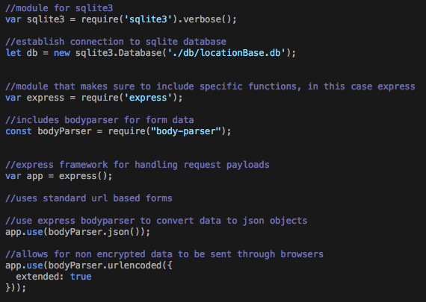
Node.js app setup

Slide 5
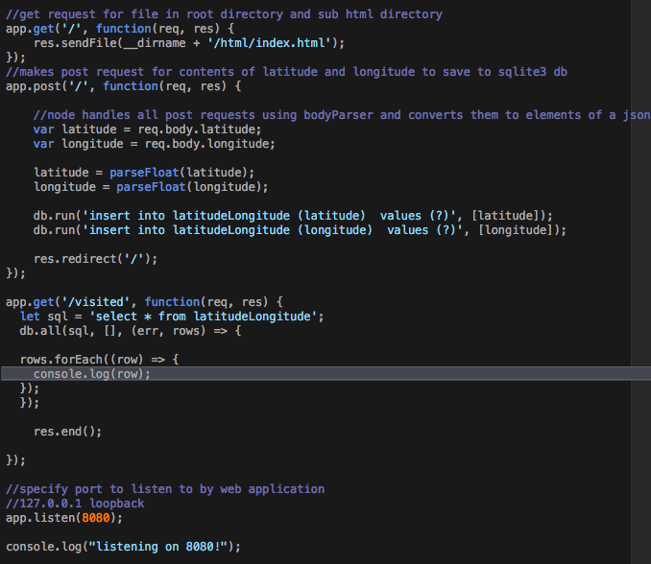

Slide 6
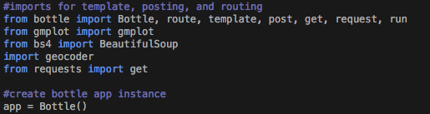

Slide 7
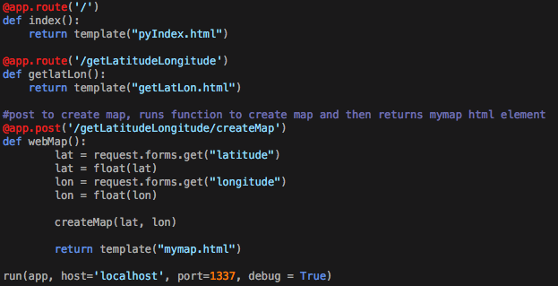

Slide 8
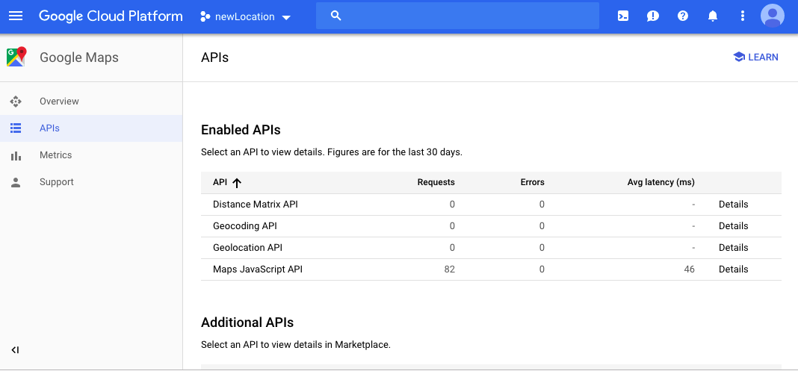

Slide 9
Geolocation by ip address vs javascript
One of the most glaring differences I found was that python didn’t have an easily consistent way to self geocode or use geolocation. So I had to settle, use self ip geolocation in python and use javascript and htmls robust geocoding. This was actually quite interesting because I noticed a very distinct dichotomy start to form.

Slide 10
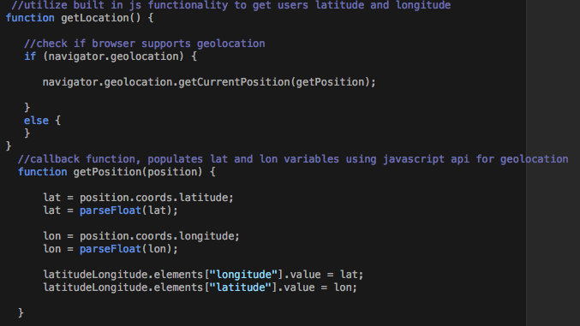
HTML/Javascript geocoding

Slide 11
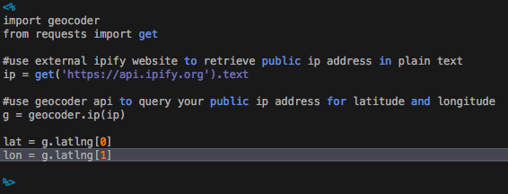

Slide 12

Javascript Result

Slide 13
Python Result

Slide 14
Interesting Results
We see that while javascripts implementation is much more “difficult” involving a callback function and messy json results, it gives us a terrifyingly accurate geolocation. While python is incredibly simple, it’s off by quite a decent margin.

Slide 15
Interfacing with google api
Api key is unique

Slide 16
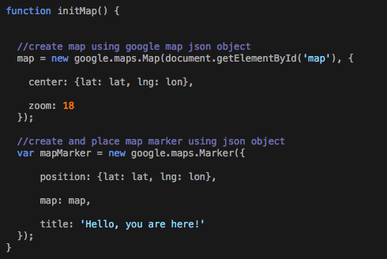

Slide 18
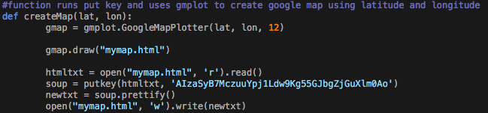

Slide 19
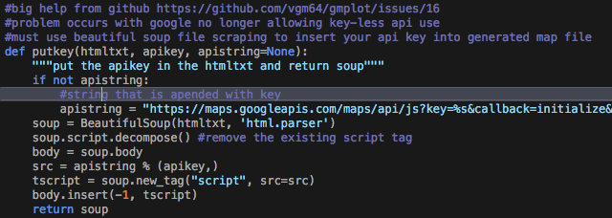

Slide 20
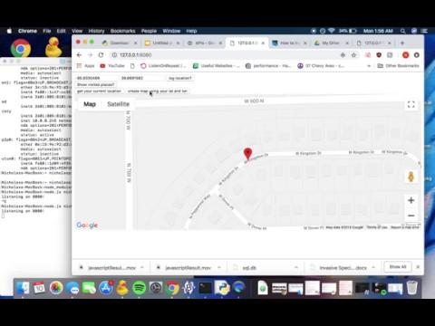
Javascript map

Slide 21
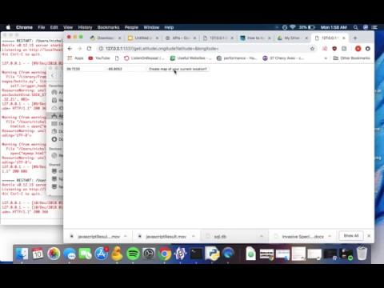
Python map

Slide 22
Conclusions
Python cannot create dynamic html pages
Javascript can
Python is much easier to use
Javascript is not
Javascript provides much more power and functionality over python

Slide 23
Sources
Google maps api docs, node js docs, geocoder docs, python map drawer github, bottle docs, sqlite3 docs, express docs

